Slide 1
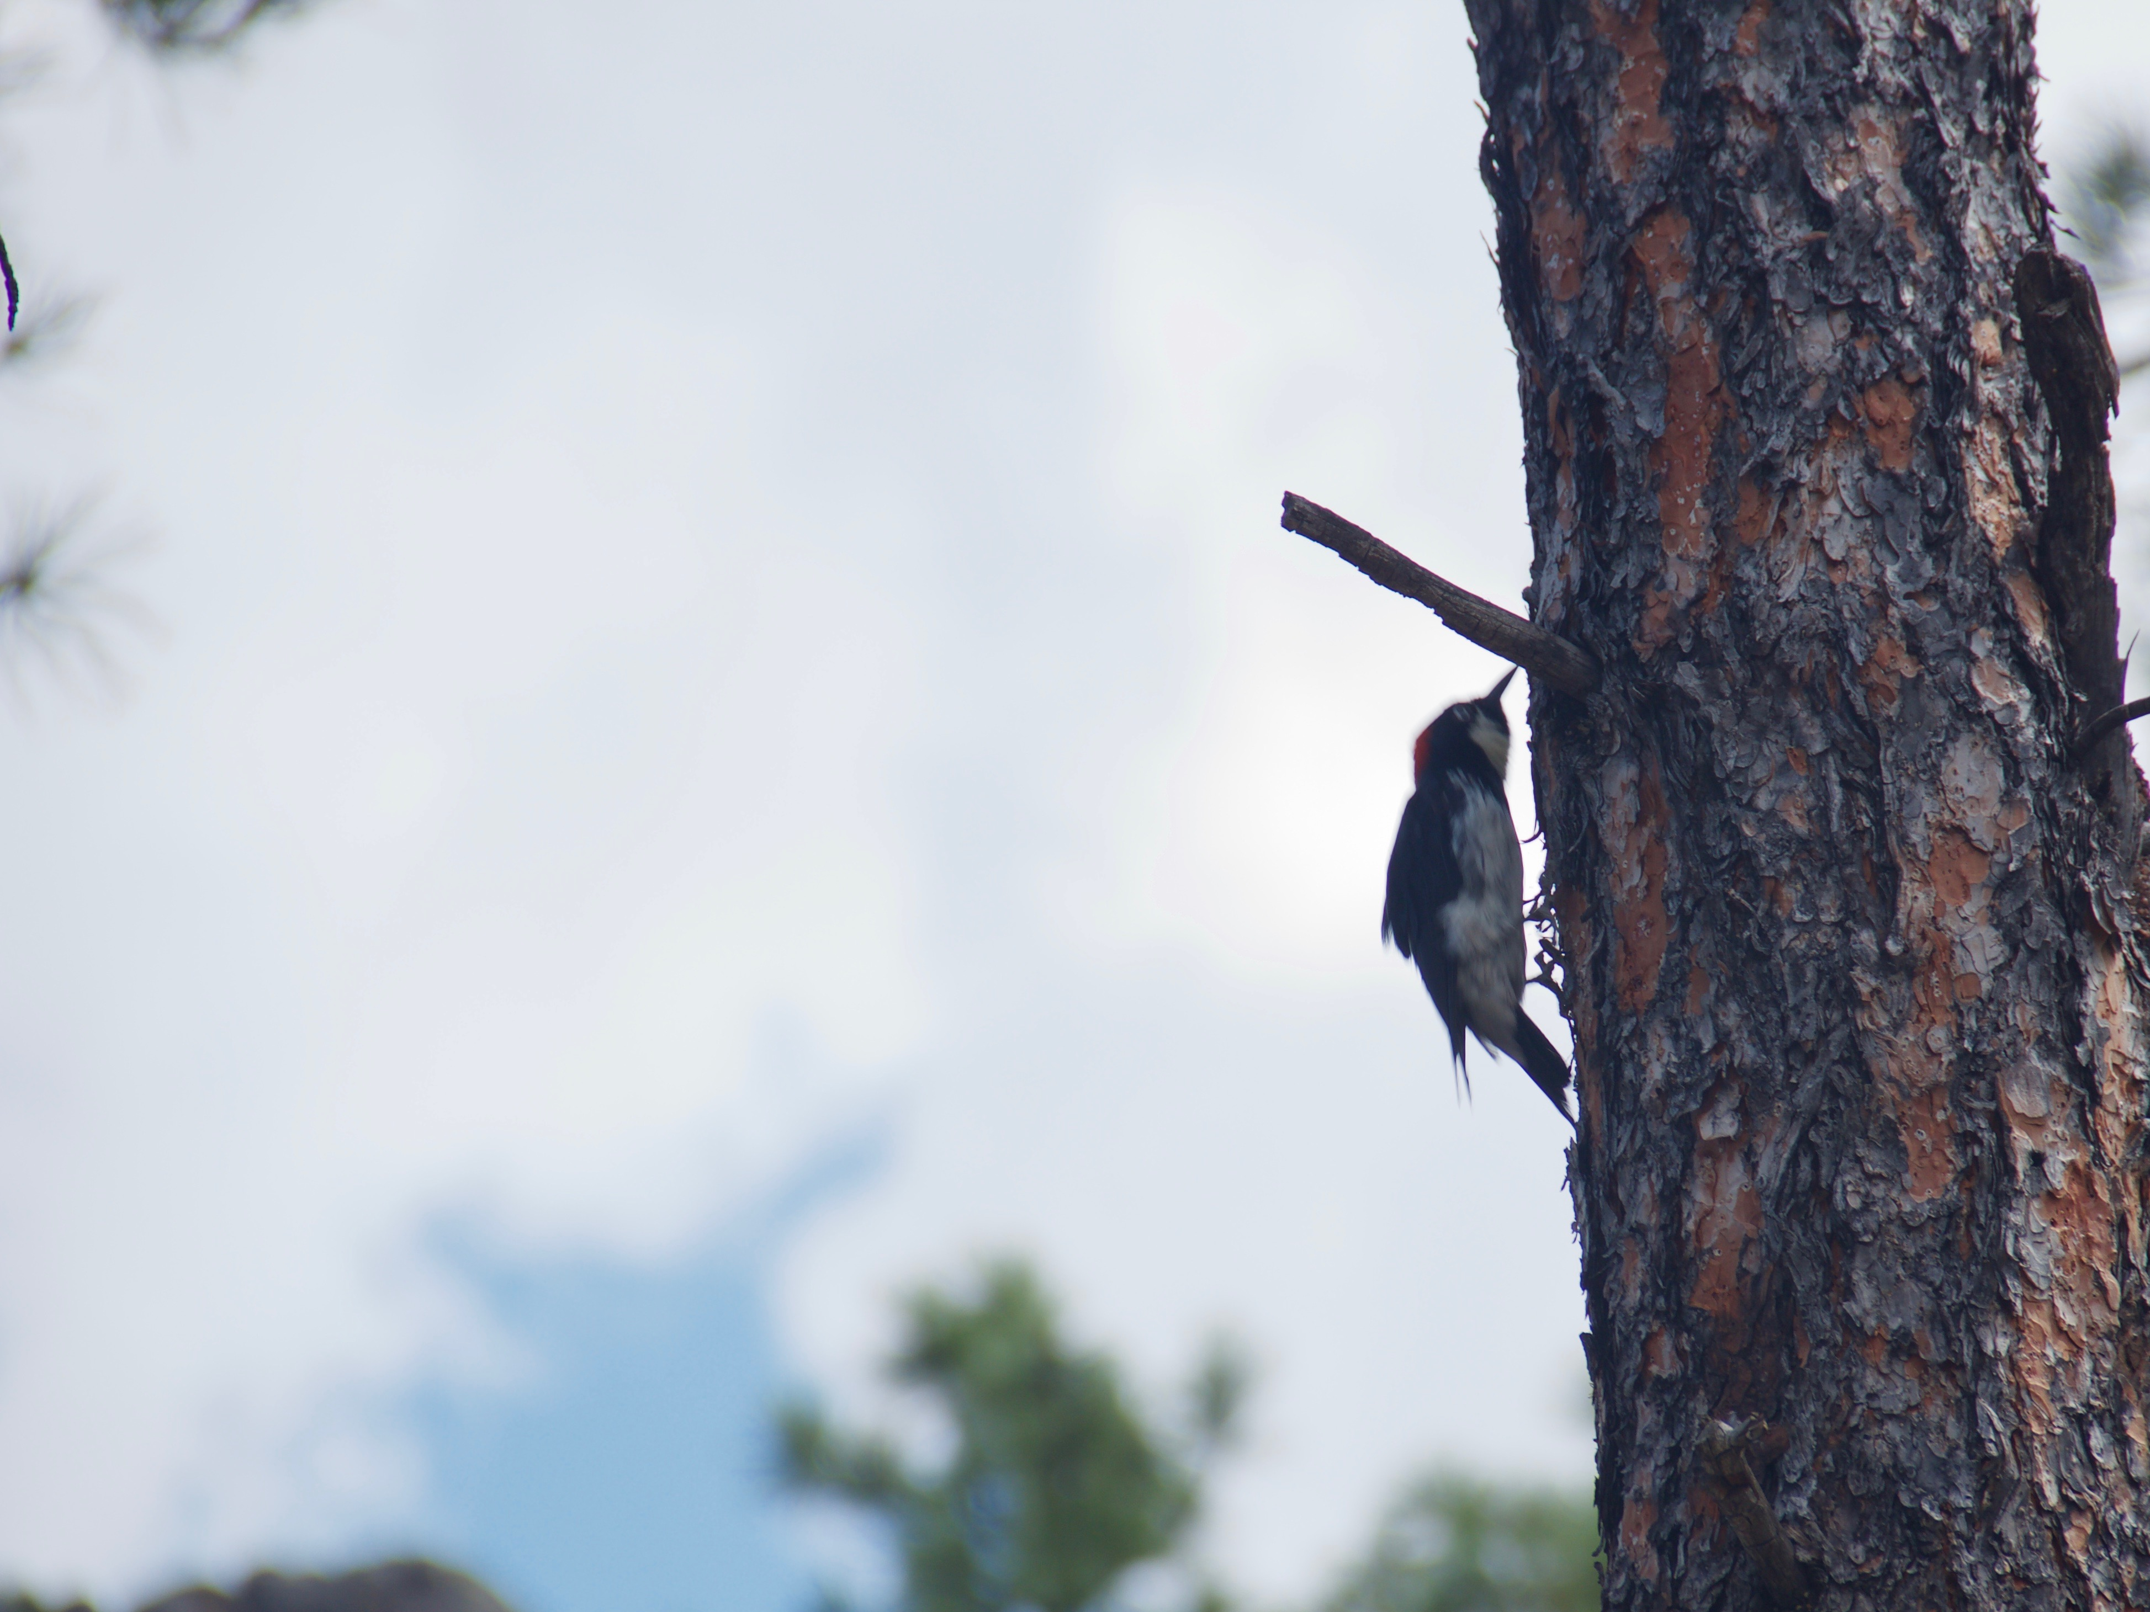
A problem; a solution:
Press. No complications; fast, easy.
No downloads, just birds.
Similarities; for identification on the fly.
Tools, and we don’t mean binoculars.
Development
Bootstrap – To build our nest.
MySQL – To put the eggs in our nest.
Apache HTTP Server – Seen around the world.
PHP – So you can extend a branch and ask a question.
Assembly Vector Editor – To illustrate pecking order.
Trello – To keep our ducks in a row.
Github – So our flock can meet.
Slack – To sing to one another.
Digital Ocean – Because the sky isn’t always blue.
Management

Slide 2

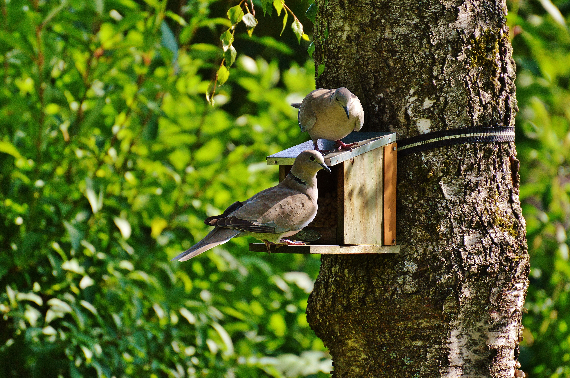
Behind the Website
Behind the Database
LANDING PAGE | GITHUB PAGES
MYSQL
ABOUT US
FILTER OPTIONS
SUBMISSIONS
SIZE SELECTION
DISPLAY PAGE
COLOR SELECTION
NOTABLE FEATURES
HTML
SIMILARITY INDEX
CSS
DISPLAY INFOMATION
BOOTSTRAP
PHP
APACHE HTTP SERVER

Slide 3
